Slide 1
Sometimes the Internet just doesn’t work…

Slide 2

The Internet is Useful, But…
Sometimes you just want to watch a video about how to give an opossum a massage

Slide 3
Problems
The Internet is complex
As the number of parts increases, the chances for failure also increase
Sometimes, the Internet just doesn’t work

Slide 4
Troubleshooting
We’ve talked about the Internet a great deal
Let’s talk about how to figure out what is wrong with it

Slide 5
Cannot Connect
What could cause this?
Fun fact: In Chrome, the page that appears when you cannot connect to the internet has a game built into, just hit space to have the dinosaur jump over cacti…

Slide 6
Cannot Connect – Possible Causes
Internet Service Provider Outage
Router Outage
Wifi Disabled

Slide 7
Cannot Connect - Solutions
Follow the ”Magic Reset” Formula (name provided courtesy of a Charter representative)
Unplug the router
Unplug the modem
Unscrew the cable going to the modem (or unplug it) for 30 seconds
Plug the modem back in
Wait for lights to stop blinking
Plug the router back in
Wait for the lights to stop blinking
Try again

Slide 8
Cannot Connect - Solutions
Router Issues
Try restarting the router by unplugging and plugging it back in
Wifi Disabled
If you’re on windows, go to Network & Internet then Change Adapter Settings
Find the Wifi Adapter and Disable then Enable it
If you’re on a mac, click the wifi icon
Click Turn Wifi Off then Turn Wifi On

Slide 9
Cannot Find Site
This usually means the Internet is working, but the address of the site cannot be found

Slide 10
Cannot Find Site - Problems
Domain name misspelled
DNS configuration wrong
DNS servers unavailable
Need to login to a proxy server (rare)

Slide 11
Cannot Find Site - Solutions
Domain name misspelled
Correct the spelling and try again
DNS misconfigured / not working
Try using a different DNS service
OpenDNS: 208.67.222.222 / 208.67.220.220
CloudFlare: 1.1.1.1 / 1.0.0.1

Slide 12
Cannot Find Site - Solutions
Proxy
Proxies are servers used to hide internet activity
They can also be used as filters for Internet activity
If you are behind a proxy and get a cannot find site error
Try going to a non-secure website (without https://)
This will generally cause the proxy to refresh and log you in again

Slide 13
Connection Refused
If you get the same error message but it is just after you clicked a link (and the Internet was working previously), then the issue isn’t DNS (most likely)
Most likely, we can’t reach the server that is supposed to be behind that page

Slide 14
Connection Refused - Problems
Your ISP is having problems
Previous website’s webmaster misspelled domain
Remote server offline
The Internet has been bombed and all the Tier 1 providers have been taken out

Slide 15
Connection Refused - Solutions
ISP having problems
See cannot connect slides
Previous webpage’s webmaster misspelled domain
Correct the domain
Also send the previous webpage’s webmaster a note so they can fix the issue
Remote server failure
If you know the owner of the website, send them a message letting them know the site is down
If it is a public company, you can see if they have a Facebook or Twitter page where you can contact them

Slide 16
Connection Refused - Solutions
Remote server failure
Not a public company or someone you know? There isn’t much else you can do but wait and hope the webmaster notices
The Internet has been bombed
Cry… ?

Slide 17
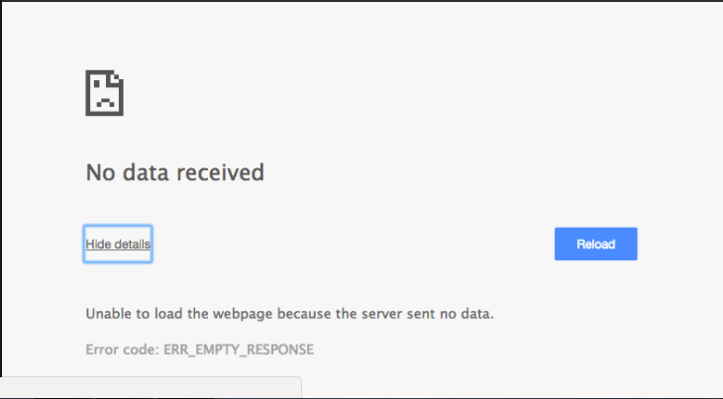
Remote Server Not Responding
We reached the server but the server didn’t respond to our request

Slide 18
Remote Server Not Responding - Causes
Heavy load
Malfunctions
Internet pathway clogged

Slide 19
Remote Server Not Responding - Solutions
Heavy load / Malfunctions
Try going to another page on the same site
If that works, come back later and try the page again
If waiting doesn’t help or the entire site is not responding, try contacting the webmaster or company on social media
Internet pathway clogged
Call your relatives and ask them to stop watching Netflix for a few minutes so you can check Facebook (just kidding, but seriously if they’re downstairs sharing the connection, might be worth a shot)
Wait 5-10 minutes and try again, if that doesn’t work, try contacting the web master or company on social media

Slide 20
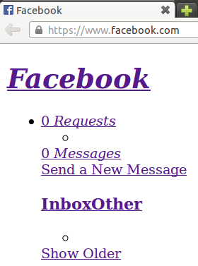
Web Page Looks Weird
Part of the web page is failing to display properly
Try reloading the page
Use the developer tools in your browser to get more information

Slide 21
Slow Performance
Web pages are loading very slowly
The issue is most likely one of four things
The site is trying to run an expensive script (check via debugging tools)
The local device is under heavy strain (task manager / activity monitor)
The local bandwidth is saturated (walk around to your family and ask what they’re doing on the internet, might want to ask your cat too just to be safe)
The local bandwidth is temporarily reduced (use a bandwidth check to see how much speed is currently available)

Slide 22
Summary
By learning about technology, we can take the principles we’ve learned and apply them to reason about the problems that we encounter while using technology

